Slide 1

PREDICTING JOB VACANCIES IN CANADA
USING MACHINE LEARNING
Wisam Ramadan
Alec Ngai
Esther Utomakili
Jerry McGranaghan
Olesya Irkhina
12/2/2021
Notes:
Good evening everyone! Hope we are having a good night so far. We hear so much about dry the labour market is currently, ever wonder how the job vacancy market is? We are group 3 consisting of Wisam, Alec, Jerry, Olesya and I and today we would be presenting how the job vacancy market is and how it may look in the future

Slide 2

AGENDA
Introduction
Approach
Results
What’s Next
Q & A
Notes:
Today we would be introducing to you our project, how we went about it, the results from our machine learning projects and what could be done next with the information we have gathered.

Slide 3

INTRODUCTION
WHAT IS THE PROJECT?

Slide 4













Project Goals
Predict future potential job vacancies in Canada
Understand underlying patterns in Canada’s job market
Data Source
Job vacancies, proportion of job vacancies and average offered hourly wage by selected characteristics, quarterly, unadjusted for seasonality (2015-2021)
What would Canada job market look like in 2025?
What jobs have most growth potential?
Technologies Used
Questions to answer
Notes:
Our project is understanding and predicting potential job vacancies in Canada as a whole and also by province. During the initial stages of the project, our goal was to prodigy potential job vacancies and see if there are any patterns in job postings.
We retrieved our data directly from Statistics Canada where job vacancies are categorized by features such as
province of job posting,
job characteristics such as full time, part time, contract and others
time of posting and
NOC code which stands for National Occupational Classification Code which defines different job types (for example, the NOC code for sales is different from the NOC code for business management)
The questions we hoped to answer with our project are:
What the job market would look like 3-5 years from now and
Which jobs (or NOC) have the most growth potential

Slide 5

APPROACH
LET’S DIVE IN!

Slide 6
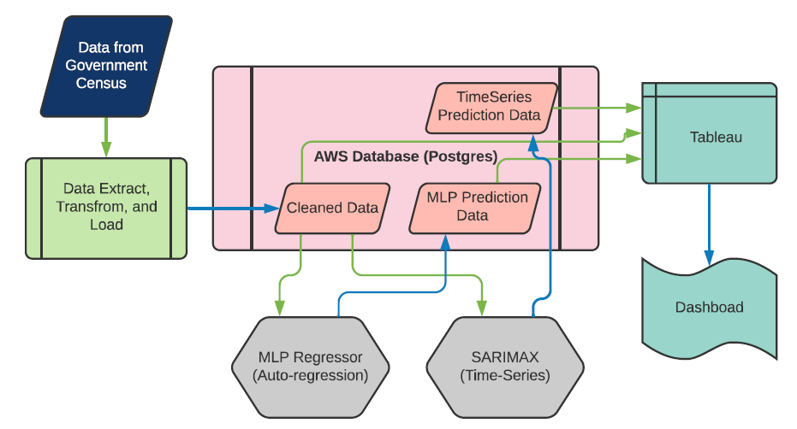
PROJECT FLOW CHART
Data Exploratory Analysis
Results Analysis and Evaluation
Machine Learning Optimization

Slide 7
DATA EXTRACTION, TRANSFORMATION AND LOADING
Data Quality
Dataset contained poor quality data and was classified using Status column.
We retained only A-D to ensure high quality data.
Key aspects we are interested in are Vacancies. These subsets of data were identified using Statistics column and retained.
We also decided to focus on Full Time and Part Time metrics which we filtered from Job Characteristics column.
Redundant columns were dropped and NOC column split into code and description.
Specific data required for Machine Learning models at Broad NOC level was placed into one table for easy connection from Pandas to run modelling.
Data Volume
Data Readiness

Slide 8
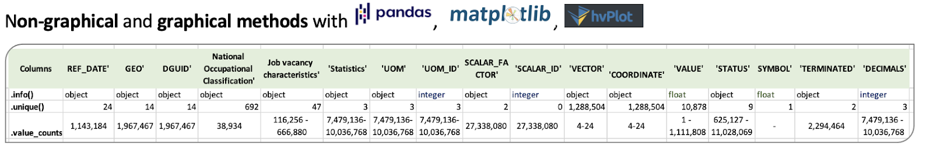
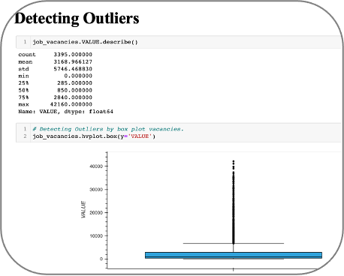
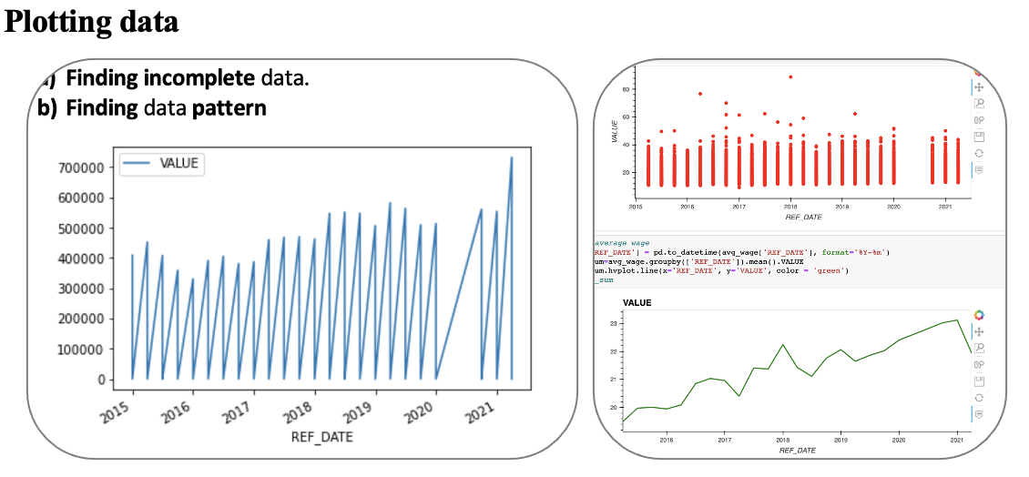
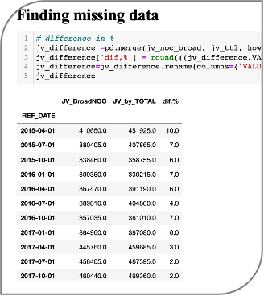
EXPLORATORY DATA ANALYSIS

Slide 9
MACHINE LEARNING MODEL SELECTION
Why SARIMAX and Multi Layer Percptron-Regressor ?
To cover all data available in the data source and predict job vacancies at broad and granular levels
Data exploratory analysis showed missing values from different provinces, NOCs, Job characteristics level
Prototypes
Arima
Random Forest
Linear Regression
Notes:
MLP:Mulit-layer Perceptron
SARIMAX
Seasonal Auto-Regressive Integrated Moving Average with eXogenous factors
GEO - Contains 13 Provinces of Canada : 'Alberta', 'British Columbia', 'Manitoba', 'New Brunswick', 'Newfoundland and Labrador', 'Northwest Territories', 'Nova Scotia', 'Nunavut', 'Ontario', 'Prince Edward Island', 'Quebec', 'Saskatchewan', 'Yukon'
This was an decided to use only the provinces so we could see how the location affects job vacancies, and throughout the data we can see it makes a big difference depending on what location you are. After the two encodings we end up with 13 new columns and we drop GEO column.
NOC - Contains 10 broad classifications: 'Business, finance and administration occupations', 'Health occupations', 'Management occupations', 'Natural and applied sciences and related occupations', 'Natural resources, agriculture and related production occupations', 'Occupations in art, culture, recreation and sport', 'Occupations in education, law and social, community and government services', 'Occupations in manufacturing and utilities', 'Sales and service occupations', 'Trades, transport and equipment operators and related occupations'
NOC allows us to see which industry on a broad level and the affect on the job vacancies and trends. After two encodings we have 10 new columns and we drop the old NOC column.
JOB_CHAR: Contains two characteristic: 'Full-time', 'Part-time'
There are many more in the original data set, however, we chose just these two for simplicity and their relation to job vacancies, since some characteristics do not have any correlation to each other. i.e. Job Vacancy for 1-5 days.
We have a total of 28 Features: 'YEAR', 'QUARTER', 'PREVIOUS_VACANCY', 'Alberta', 'British Columbia', 'Manitoba', 'New Brunswick', 'Newfoundland and Labrador', 'Northwest Territories', 'Nova Scotia', 'Nunavut', 'Ontario', 'Prince Edward Island', 'Quebec', 'Saskatchewan', 'Yukon', 'Business, finance and administration occupations', 'Health occupations', 'Management occupations', 'Natural and applied sciences and related occupations', 'Natural resources, agriculture and related production occupations', 'Occupations in art, culture, recreation and sport', 'Occupations in education, law and social, community and government services', 'Occupations in manufacturing and utilities', 'Sales and service occupations', 'Trades, transport and equipment operators and related occupations', 'Full-time', 'Part-time'

Slide 10
FEATURE SELECTION AND ENGINEERING
MLP
SARIMAX
Feature Selection | Feature Engineering
Input (28 Features) Vacancy Date ( Year , Quarter) Province Broad National Occupation Classification(NOC) Job Characteristics full time Job Characteristics part time Granular level Previous Quarter Vacancy Output Predicted vacancies | Creation of previous quarter vacancy Creation of Year and Quarter columns One hot encoding Label Encoding Standard Scaler
Feature Selection | Feature Engineering
Input Vacancy Date Vacancies on Canada level, all NOCs, All work types Vacancies on province level, all NOCs, All work types Output Predicted vacancies | Imputation of missing data in Canada and province level
Notes:
MLP:Mulit-layer Perceptron
SARIMAX
Seasonal Auto-Regressive Integrated Moving Average with eXogenous factors
GEO - Contains 13 Provinces of Canada : 'Alberta', 'British Columbia', 'Manitoba', 'New Brunswick', 'Newfoundland and Labrador', 'Northwest Territories', 'Nova Scotia', 'Nunavut', 'Ontario', 'Prince Edward Island', 'Quebec', 'Saskatchewan', 'Yukon'
This was an decided to use only the provinces so we could see how the location affects job vacancies, and throughout the data we can see it makes a big difference depending on what location you are. After the two encodings we end up with 13 new columns and we drop GEO column.
NOC - Contains 10 broad classifications: 'Business, finance and administration occupations', 'Health occupations', 'Management occupations', 'Natural and applied sciences and related occupations', 'Natural resources, agriculture and related production occupations', 'Occupations in art, culture, recreation and sport', 'Occupations in education, law and social, community and government services', 'Occupations in manufacturing and utilities', 'Sales and service occupations', 'Trades, transport and equipment operators and related occupations'
NOC allows us to see which industry on a broad level and the affect on the job vacancies and trends. After two encodings we have 10 new columns and we drop the old NOC column.
JOB_CHAR: Contains two characteristic: 'Full-time', 'Part-time'
There are many more in the original data set, however, we chose just these two for simplicity and their relation to job vacancies, since some characteristics do not have any correlation to each other. i.e. Job Vacancy for 1-5 days.
We have a total of 28 Features: 'YEAR', 'QUARTER', 'PREVIOUS_VACANCY', 'Alberta', 'British Columbia', 'Manitoba', 'New Brunswick', 'Newfoundland and Labrador', 'Northwest Territories', 'Nova Scotia', 'Nunavut', 'Ontario', 'Prince Edward Island', 'Quebec', 'Saskatchewan', 'Yukon', 'Business, finance and administration occupations', 'Health occupations', 'Management occupations', 'Natural and applied sciences and related occupations', 'Natural resources, agriculture and related production occupations', 'Occupations in art, culture, recreation and sport', 'Occupations in education, law and social, community and government services', 'Occupations in manufacturing and utilities', 'Sales and service occupations', 'Trades, transport and equipment operators and related occupations', 'Full-time', 'Part-time'

Slide 11

RESULTS
LOOKING THROUGH THE DATA

Slide 12
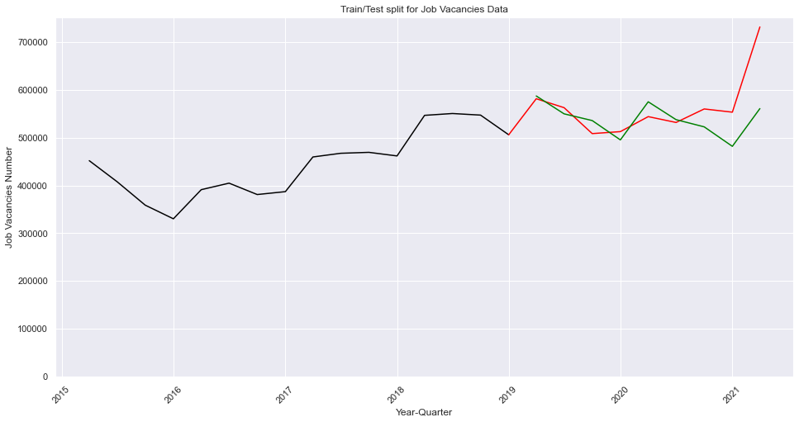
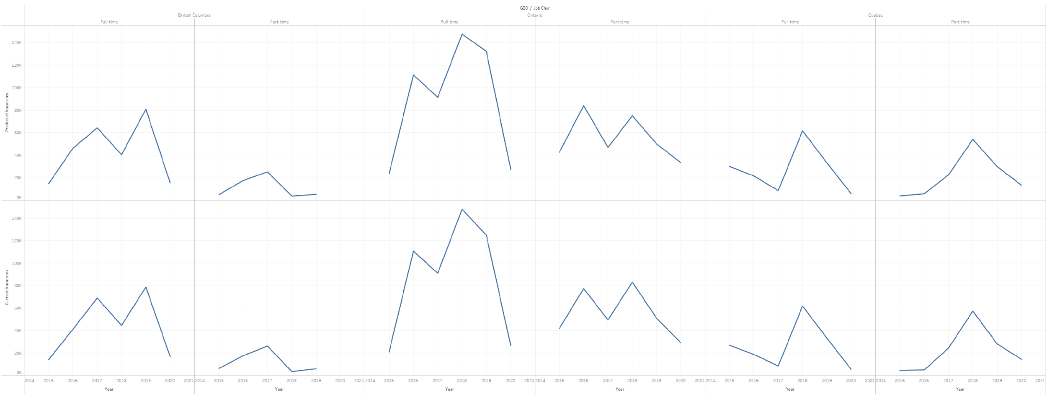
MACHINE LEARNING MODELS
MLP
SARIMAX
Accuracy Measures
MLP “Relu” “Adam” Multi-Layer Perceptron Regressor | Score: 0.981 Root Mean Square Error :790.1 | SARIMAX Seasonal Auto-Regressive Integrated Moving Average with eXogenous factors | Explained Variance Score : 0.12 Root Mean Square Error : 254.9
Notes:
High Errors explanation: both models have lots of parameters to configure and we applied grid search to choose the best combination.
Limited time for back propagation
This type of data has limited research in literature
Red
Trends match

Slide 13
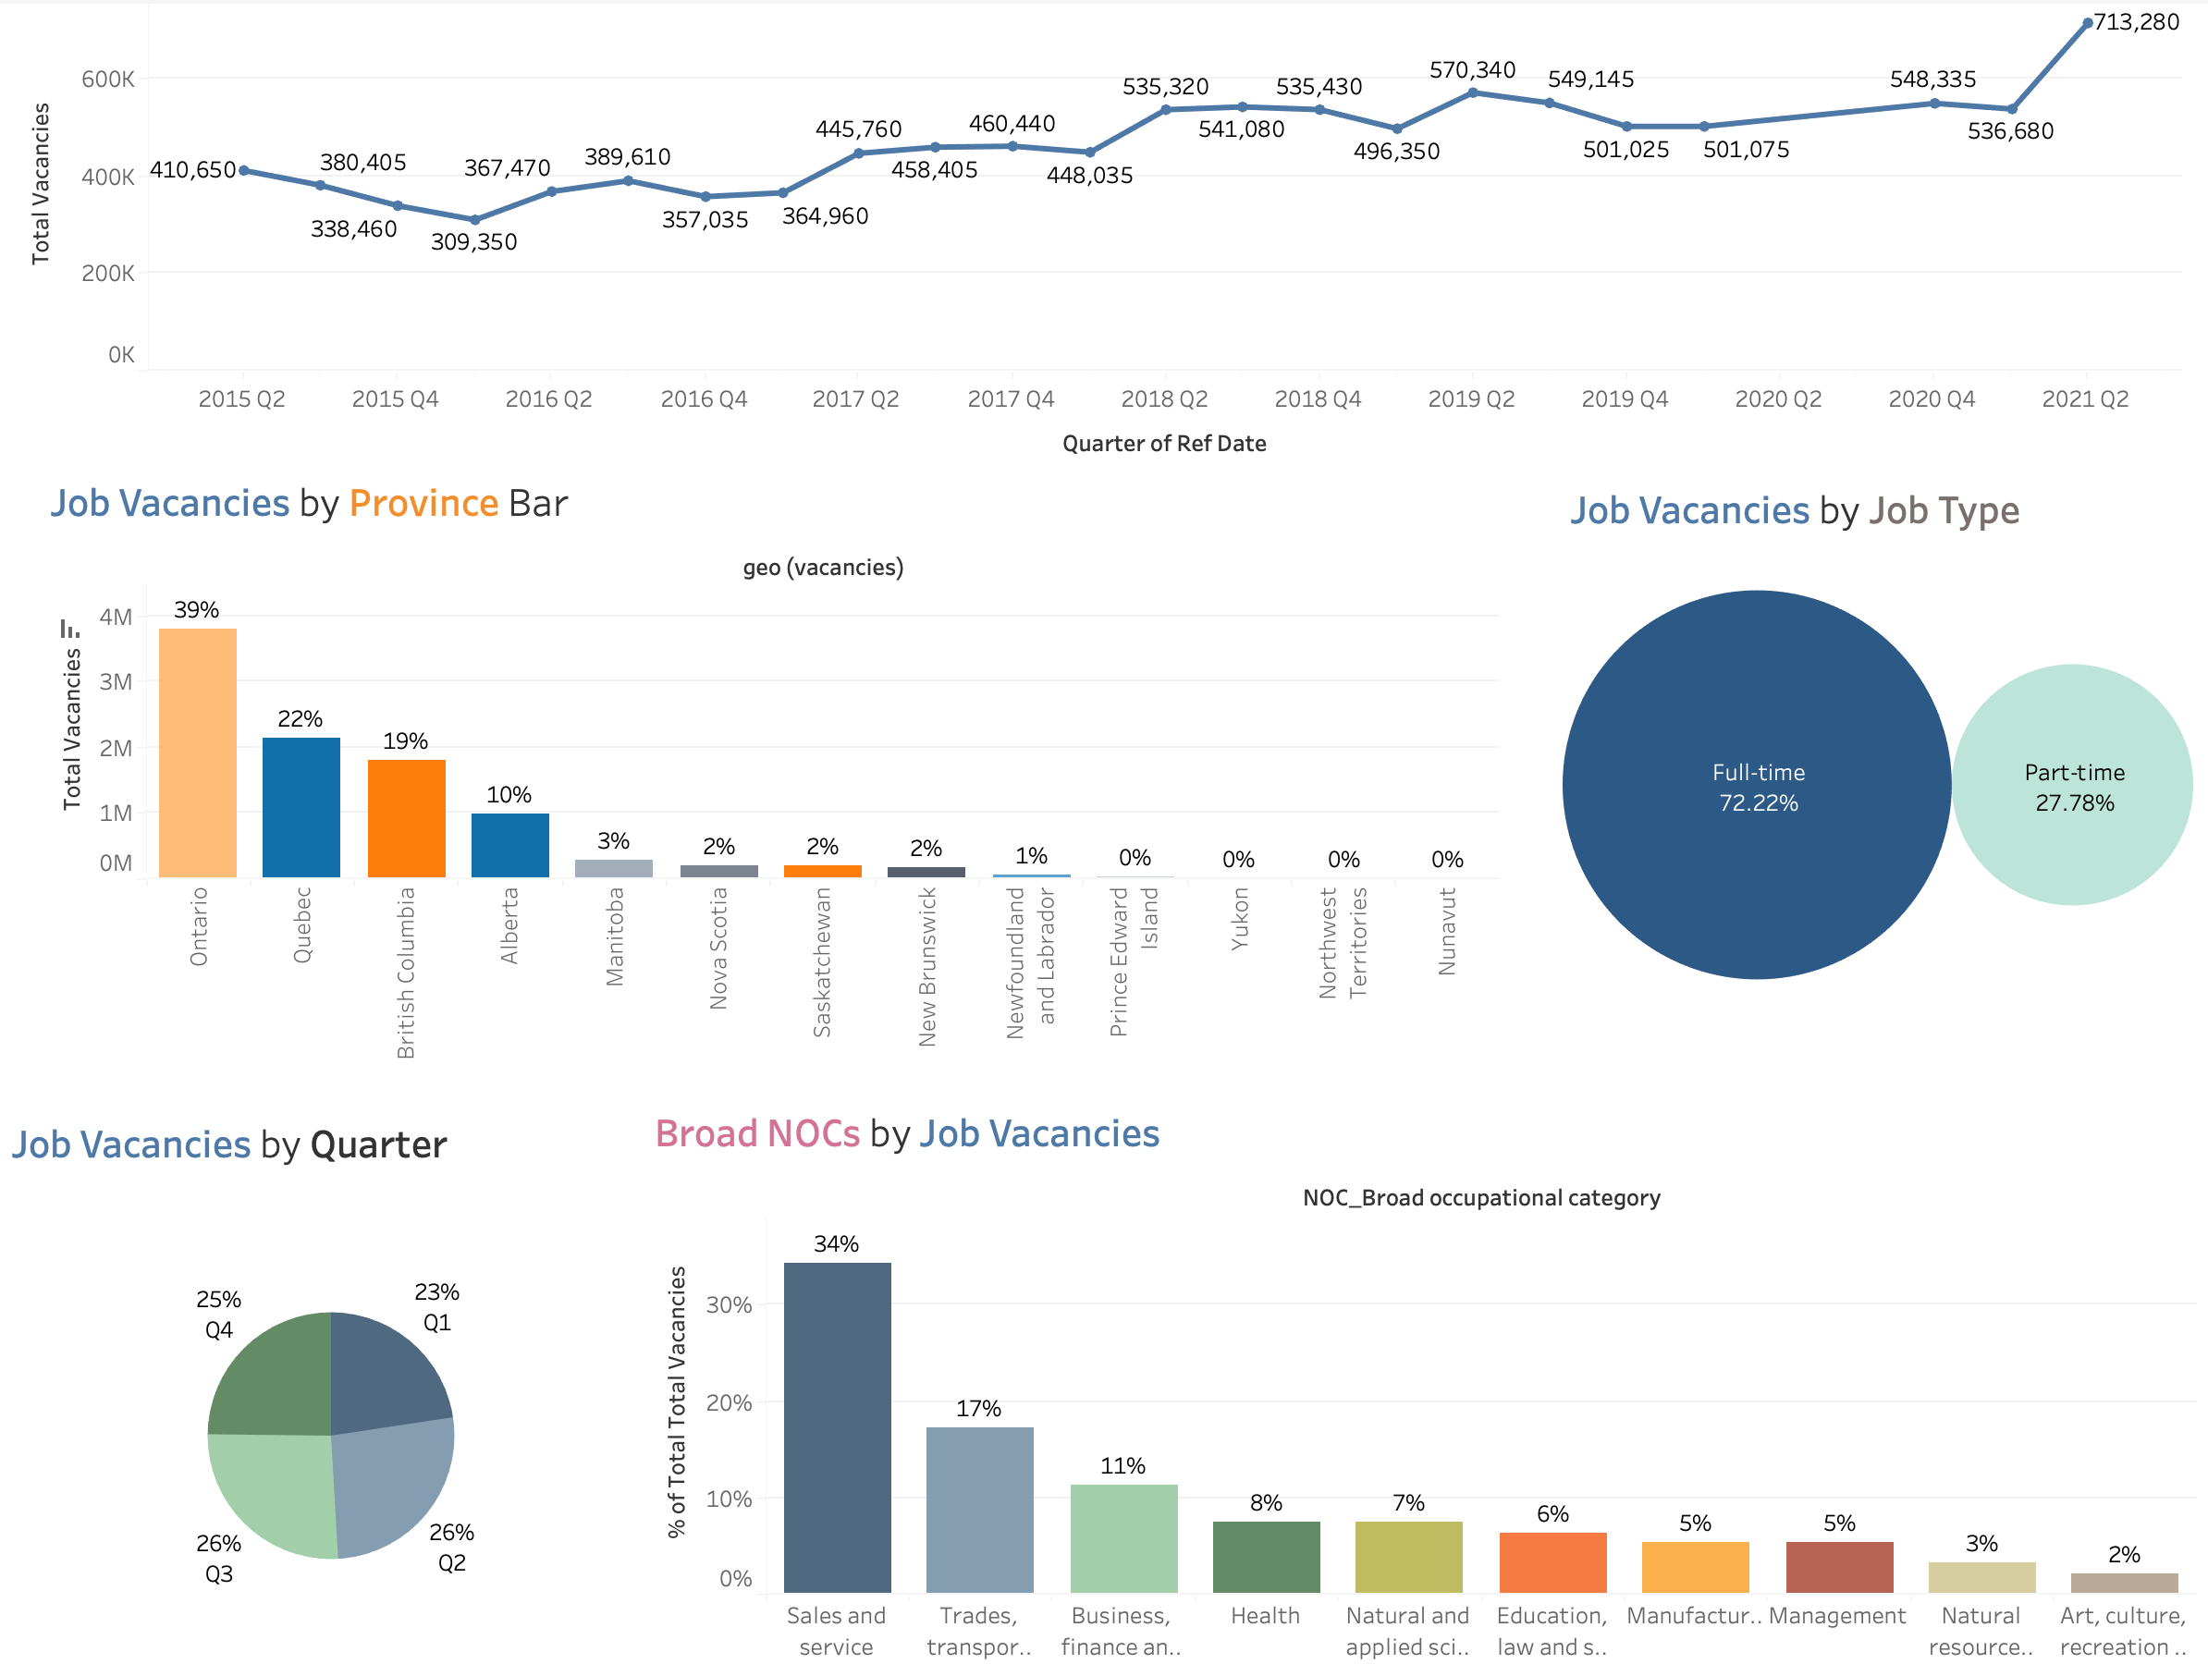
Dashboard

Slide 14
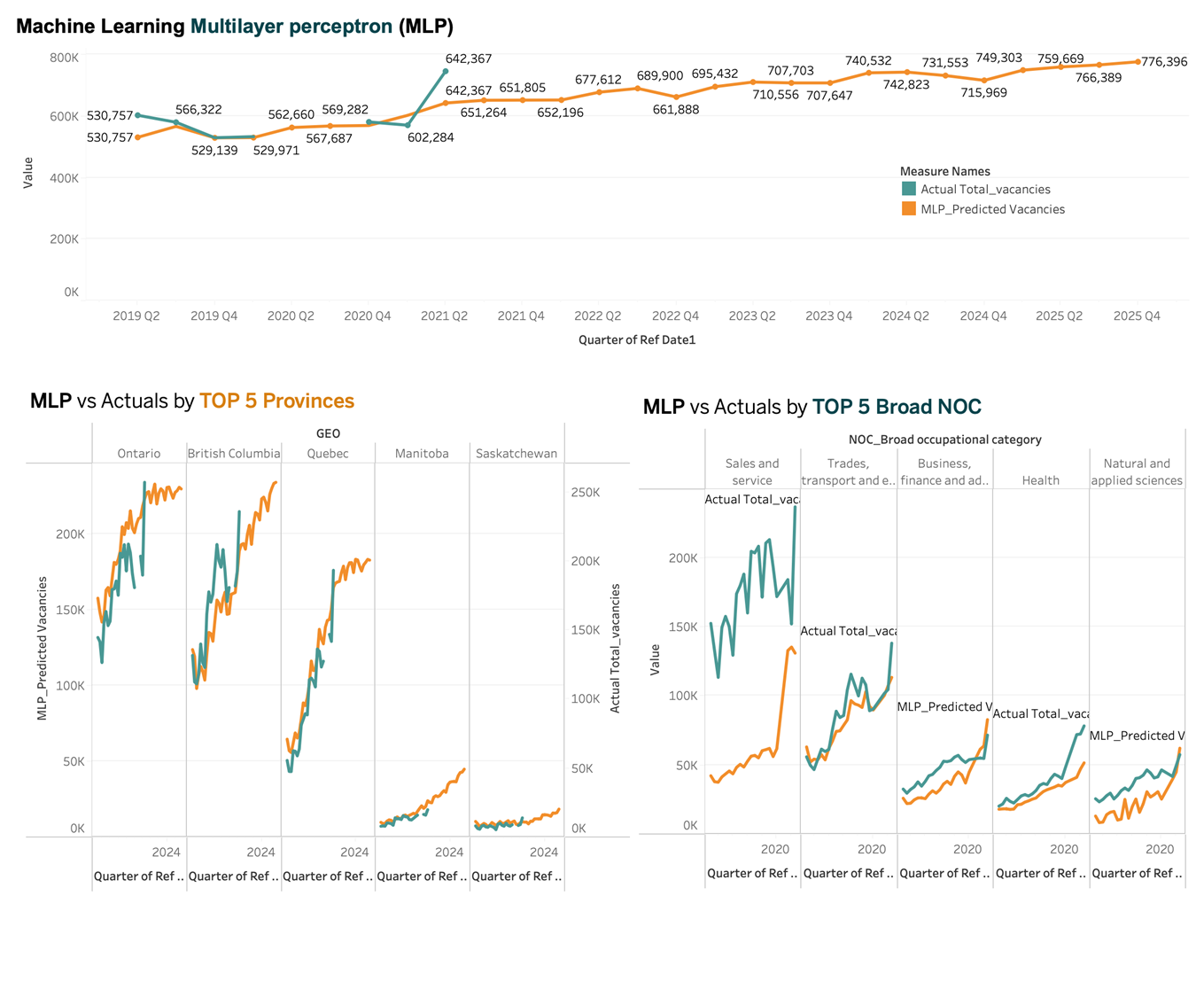

Slide 15
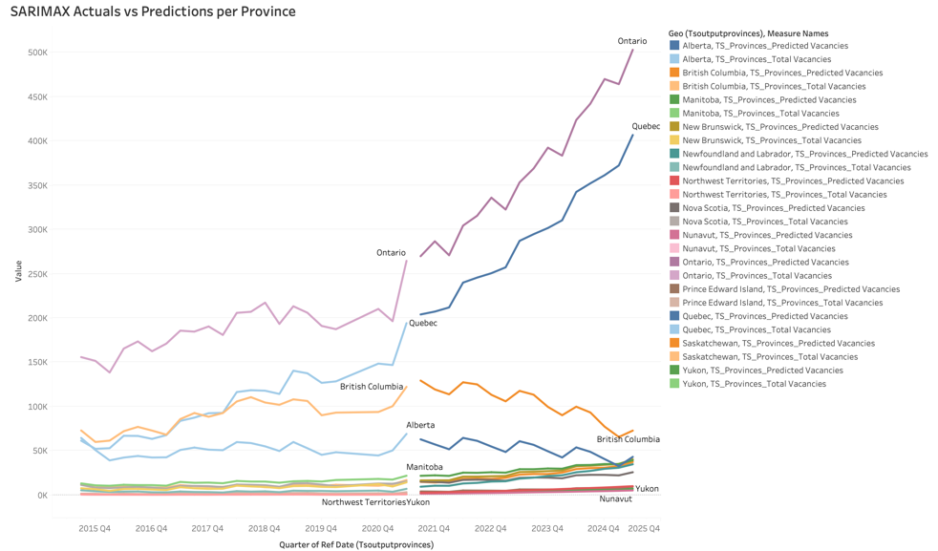

Slide 16
LOOKING AHEAD
WHAT’S NEXT?

Slide 17

KEY TAKEAWAYS
MLP is efficient for predicting data with multiple categorical variable.
SARIMAX is efficient in incorporating seasonal and trend patterns from time related variables and focused predictions.
MLP and SARIMAX are useful for predicting future values of time related variables.

Slide 18



FUTURE RESEARCH
Applicability to similar business cases
Categorical data with time features
Incorporation
Of additional data
Time sensitive models are more prone to smaller data sets, increasing data points increases model performance
Granular job classifications
Expand MLP model to include granular job classification
Notes:
Talk about broad nocs

Slide 19
QUESTIONS ANYONE?
Q & A

Slide 20
THANK YOU!
Wish you all the best!

